Slide 1
Data Preprocessing on Heart Attack Risk Prediction Dataset
By:
Thilok Reddy Anugu, Sree Chandana Kurella and Vineela Velaga

Slide 2
Contents
Introduction
Pre-processing Operations
Inference and Analysis
References

Slide 3
Introduction
This dataset comprises a wide range of critical factors related to heart health and lifestyle choices.
It includes patient-specific details such as age, gender, cholesterol levels, blood pressure, and health indicators like diabetes, family history, smoking habits, obesity, and alcohol consumption.
Additionally, it covers lifestyle factors including exercise hours, dietary preferences, stress levels, and sedentary hours.
The dataset also incorporates essential medical aspects like previous heart problems, medication usage, and triglyceride levels.
Socioeconomic factors such as income and geographic attributes like country, continent are considered.

Slide 4
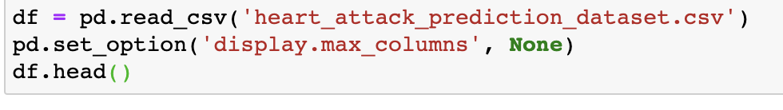
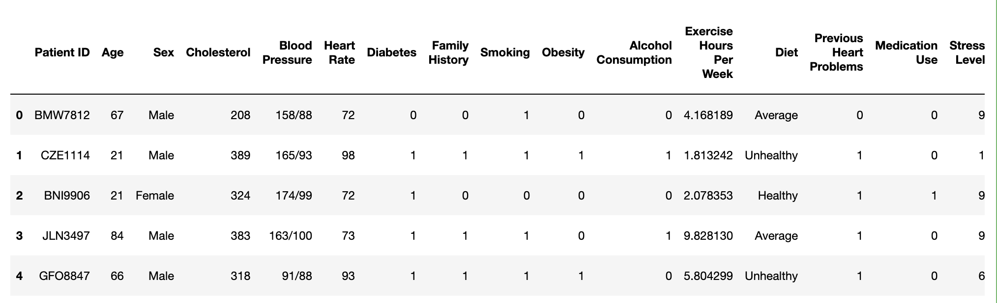
The dataset

Slide 5

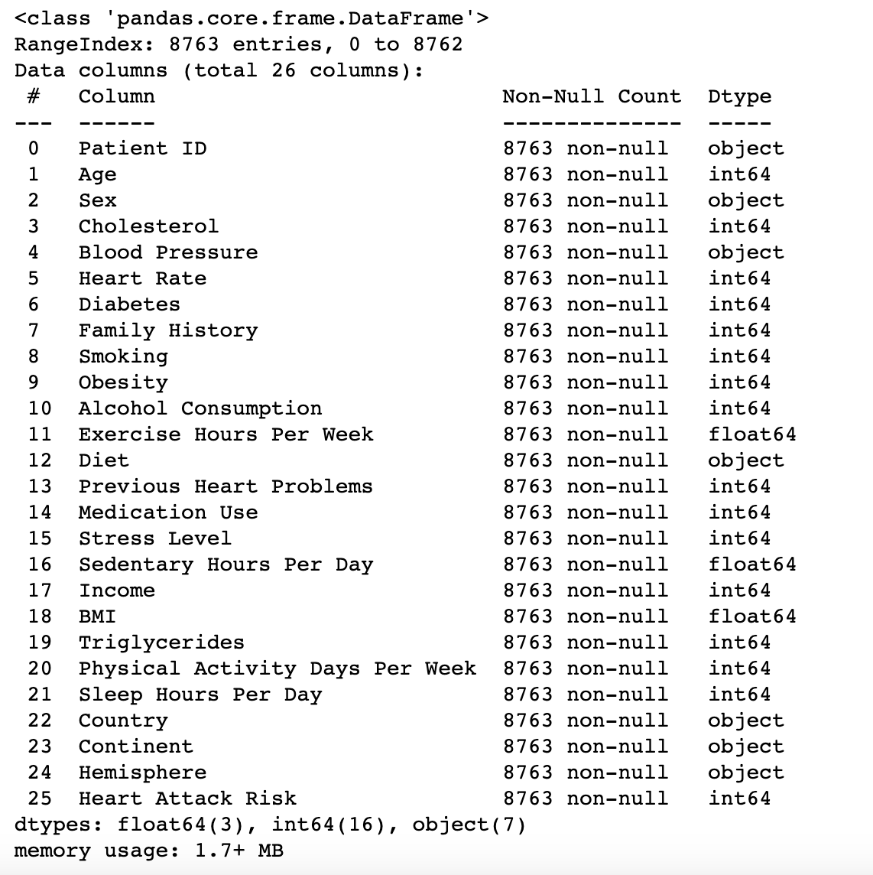
Preprocessing Operations
Data Exploration
It helps you understand the structure of the dataset, identify missing values, and check the data types of columns, which is essential for further data preparation and cleaning.

Slide 6

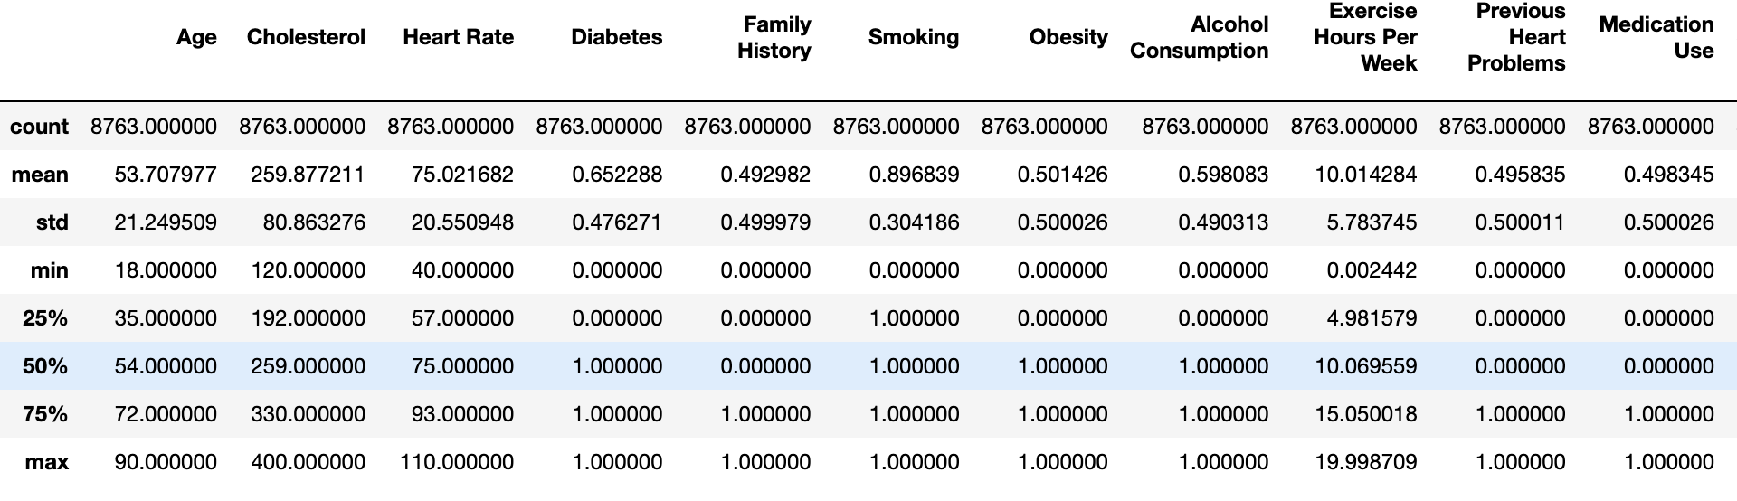
Data Exploration
df.describe() helps you quickly understand the distribution of numerical data in your dataset.
It provides insights into the data's central tendency (mean, median), spread (standard deviation), and quartiles.
This information is valuable for identifying potential outliers, understanding data ranges, and getting a sense of the data's overall distribution.

Slide 7
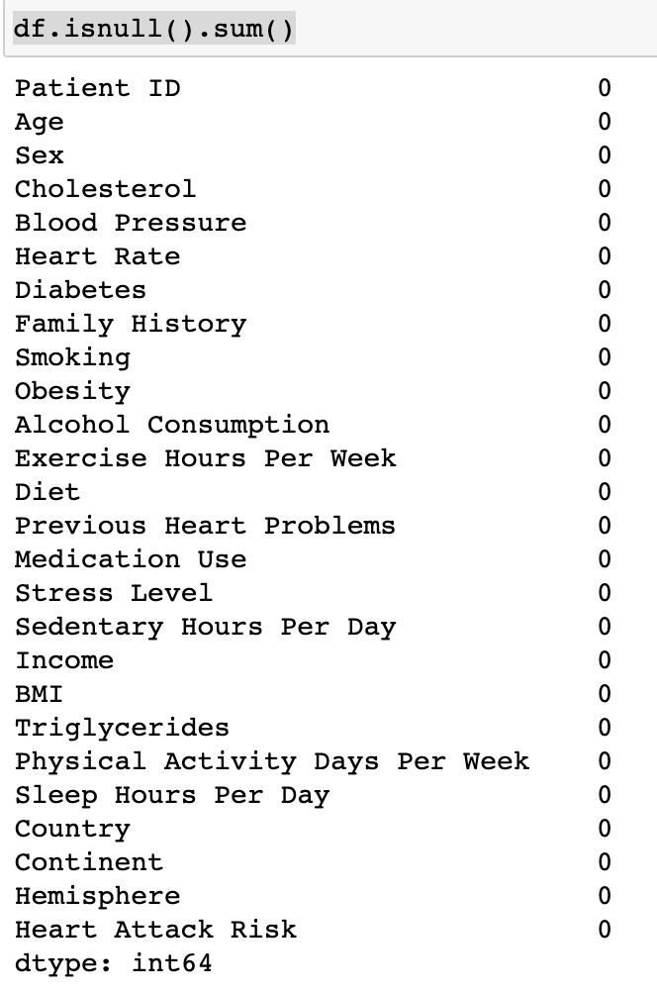
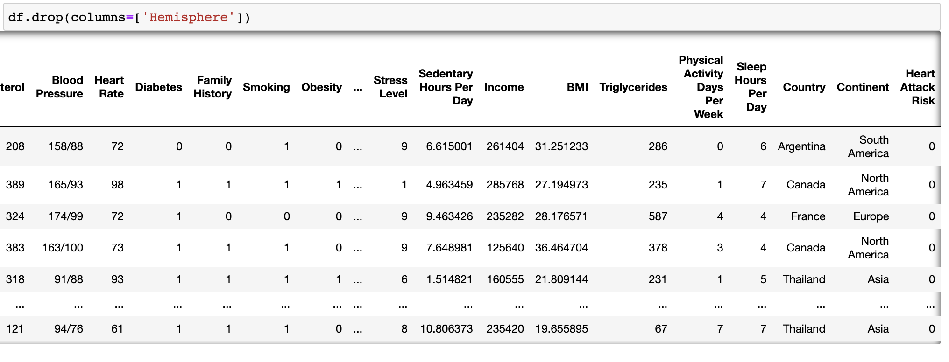
Data Cleaning
Identifying Null values in each column of the DataFrame.
Dropping irrelevant columns can make the dataset more focused and reduce the dimensionality of the data, which can be beneficial for some analysis tasks.

Slide 8
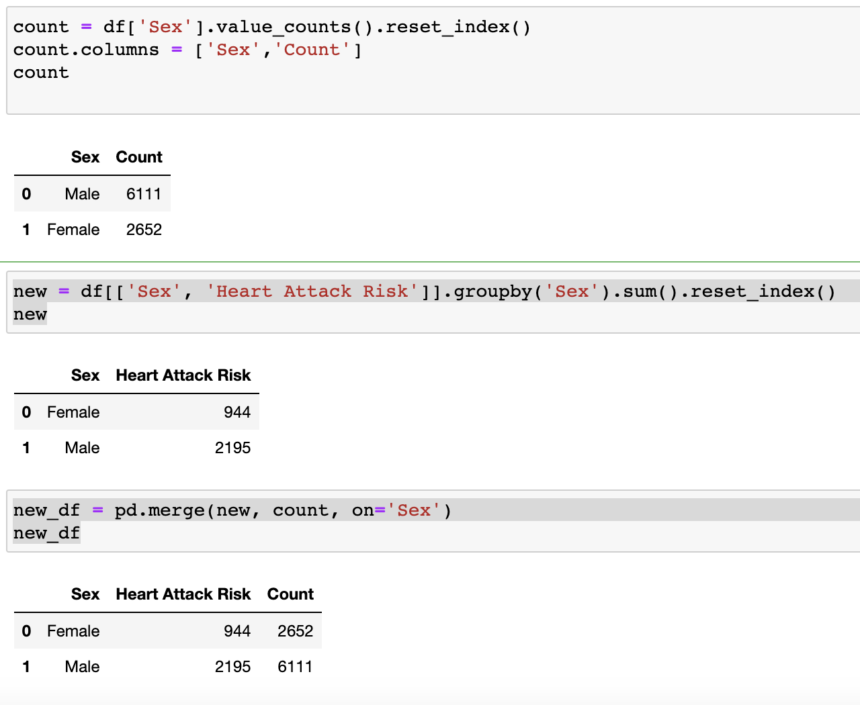
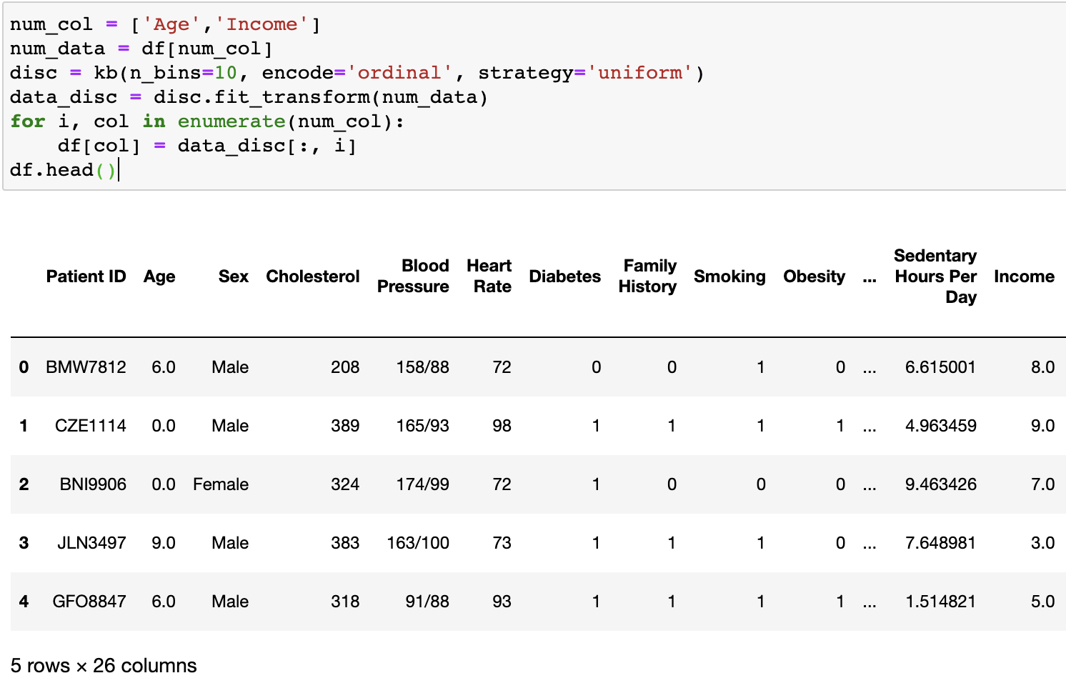
Data Transformation
Discretization: performing discretization on the 'Age' and 'Income' columns. This will convert a continuous variable into distinct intervals or bins. Instead of having a continuous range of values, you create discrete categories or groups. This can make it easier to analyze and interpret the data.
Data Filtering and Aggregation: analyze the relationship between gender and heart attack risk.

Slide 9
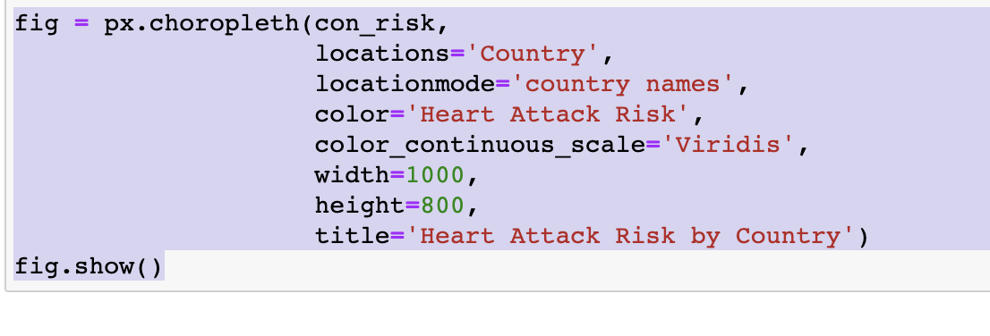
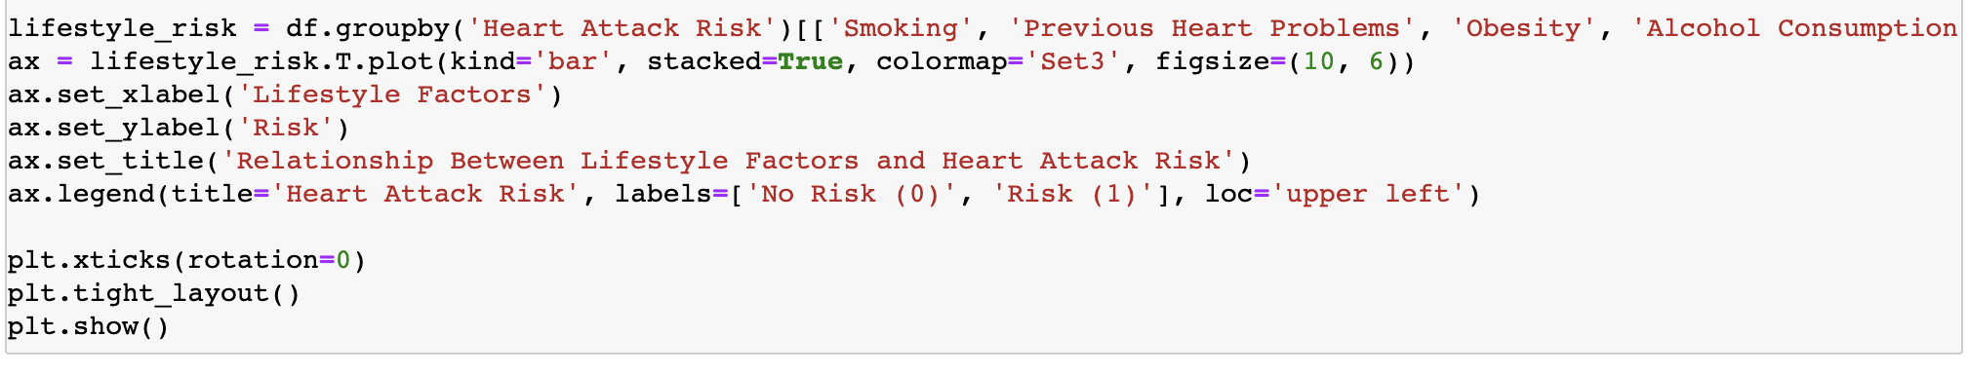
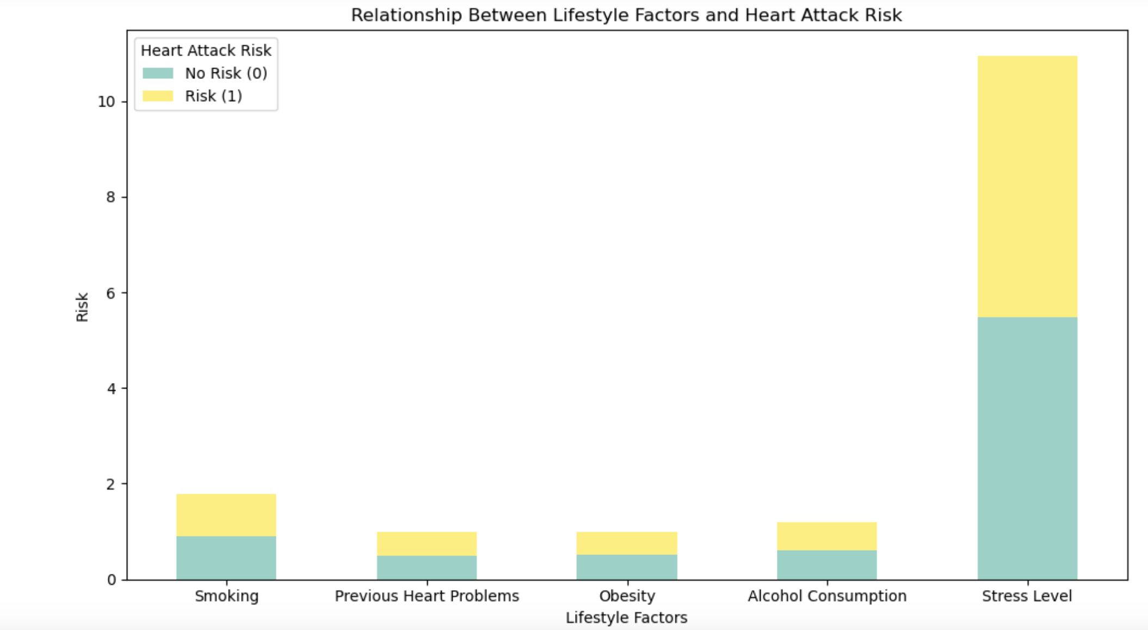
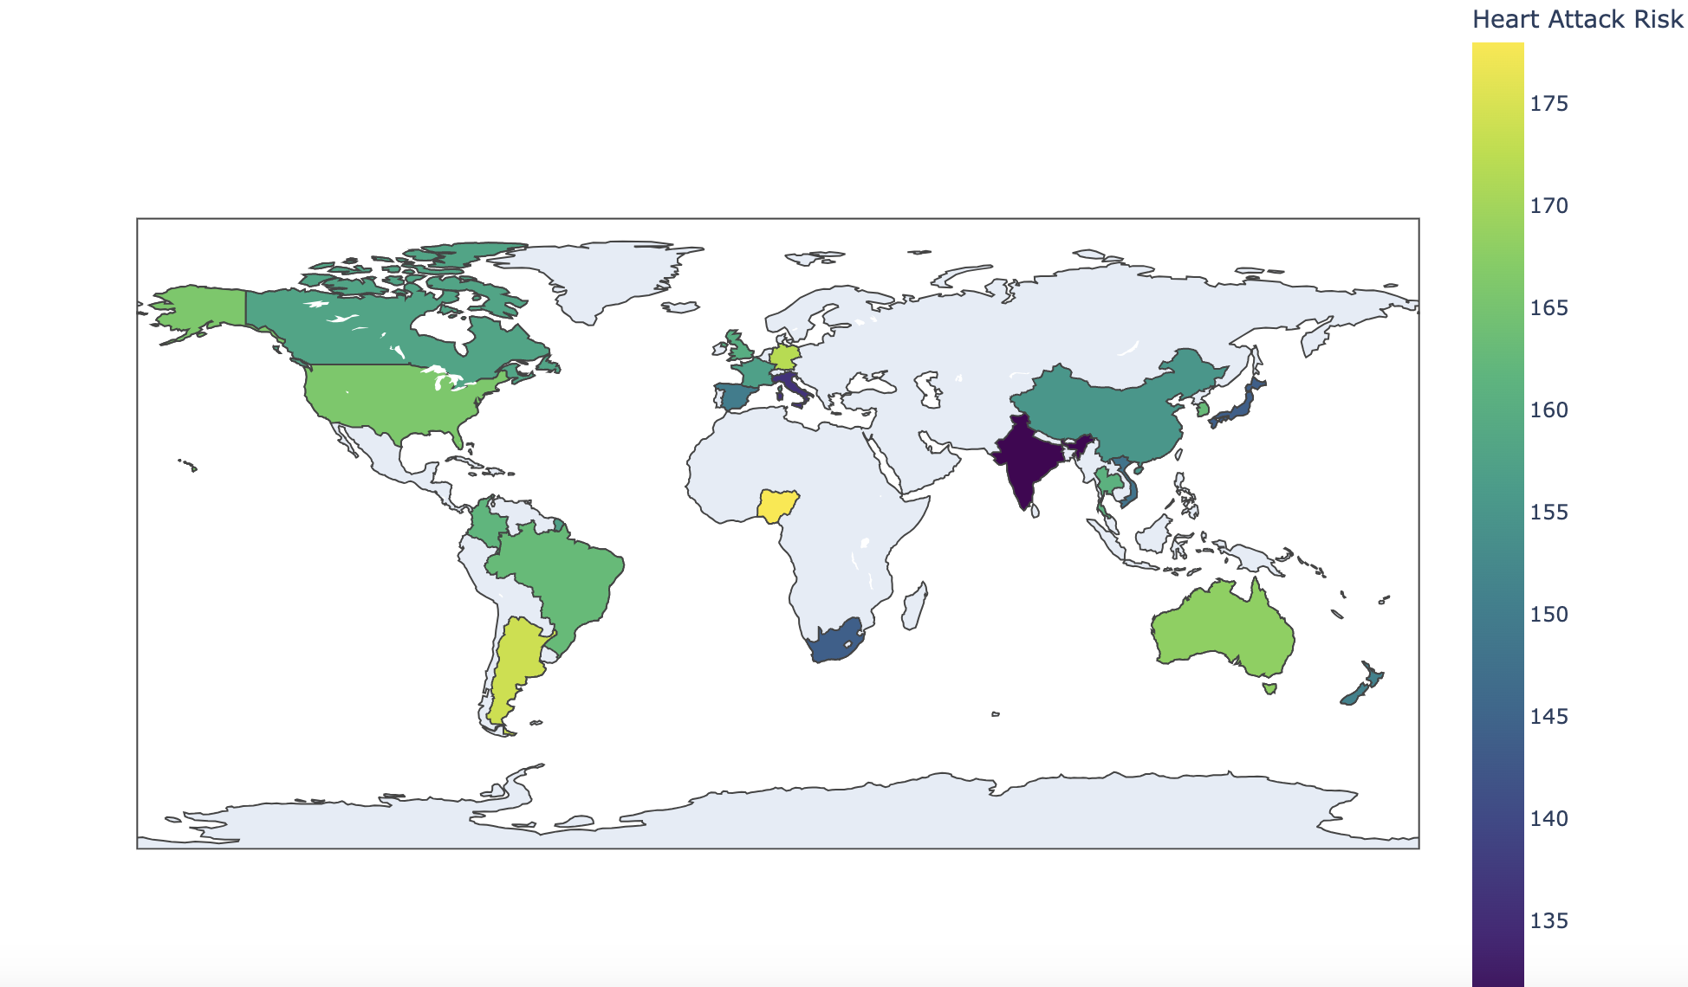
Data Summarization and Visualization
Choropleth : Choropleth maps are a valuable tool for summarizing and communicating geographic data insights.
It visually represents the heart attack risk by country, making it easy to observe geographic patterns and variations in heart attack risk across different regions.
Stacked Bar Chart: This type of graph effectively shows how different lifestyle factors contribute to heart attack risk and allows for easy comparison between risk categories (No Risk and Risk).

Slide 10
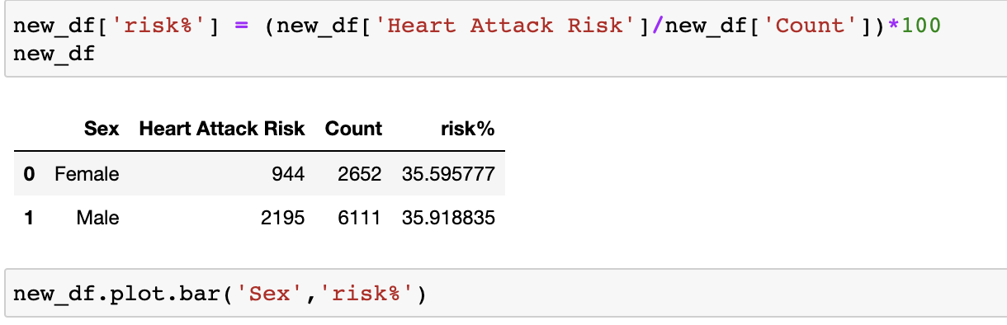
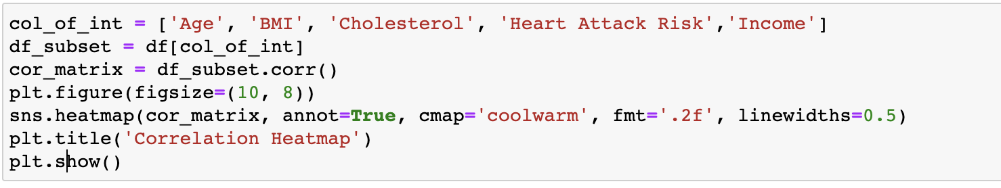
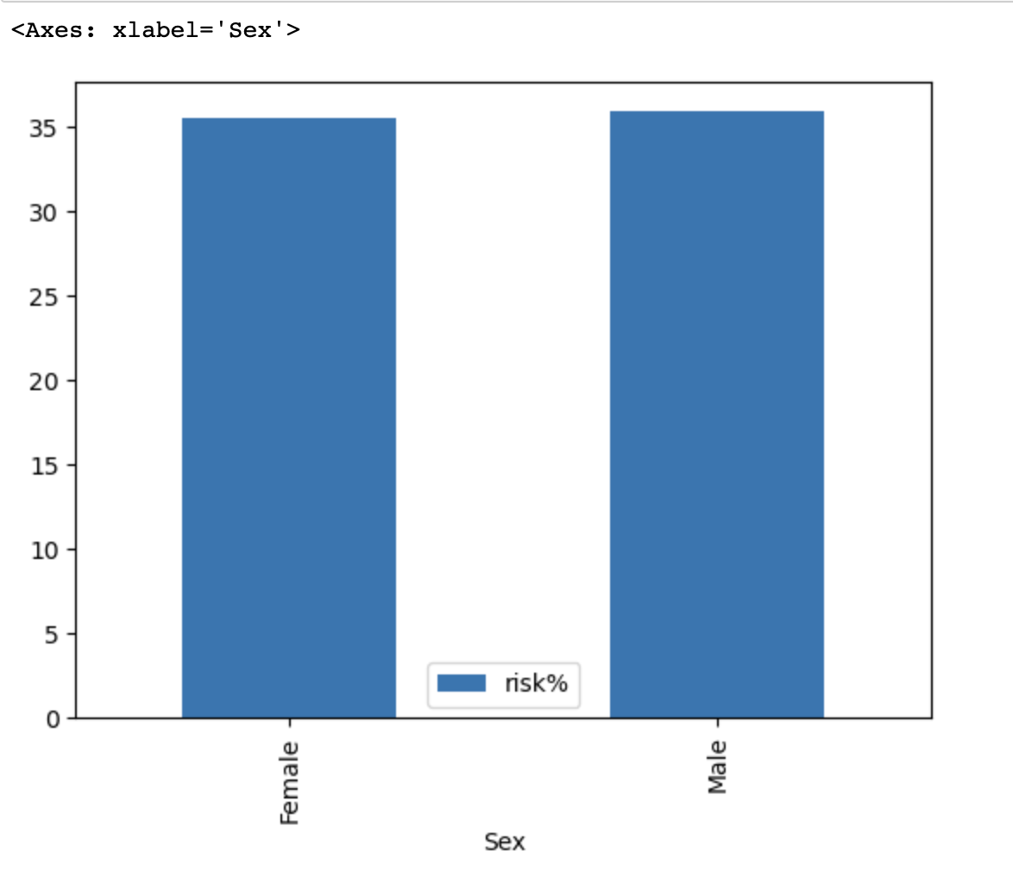
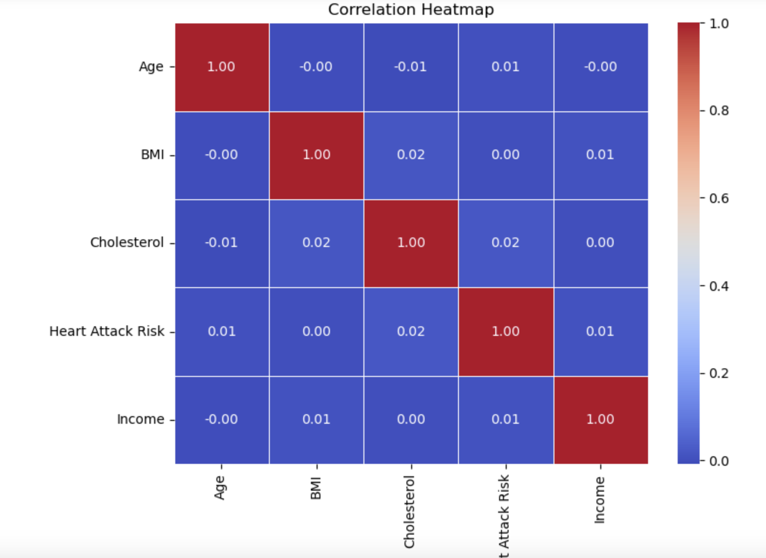
Bar Chart : This visualization can help you compare the risk percentages between genders.
Heat Map: It represents the correlations between various factors. Positive correlations are indicated by warmer colors (closer to 1), while negative correlations are represented by cooler colors (closer to -1).

Slide 11
Inference and Analysis
The "Heart Attack Prediction" dataset provides a rich source of information for inferring risk factors, geographic variations, lifestyle impacts, and more related to heart attacks. These inferences can have practical applications in healthcare, public health, and research in cardiovascular health.
the "Heart Attack Prediction" dataset allows for the analysis of:
Correlations between factors and heart attack risk.
Gender-based and geographic analyses.
Identification of key risk factors.
Development of predictive models.
Lifestyle impact assessment.
Temporal trends and patient profiling.
Economic implications of heart attacks.

Slide 12
References
DataSet: https://www.kaggle.com/datasets/iamsouravbanerjee/heart-attack-prediction-dataset
Scikit-learn Module: https://scikit-learn.org/stable/modules/preprocessing.html
Matplotbit: https://matplotlib.org/stable/index.html
Seaborn Library: https://seaborn.pydata.org/

